Slide 1
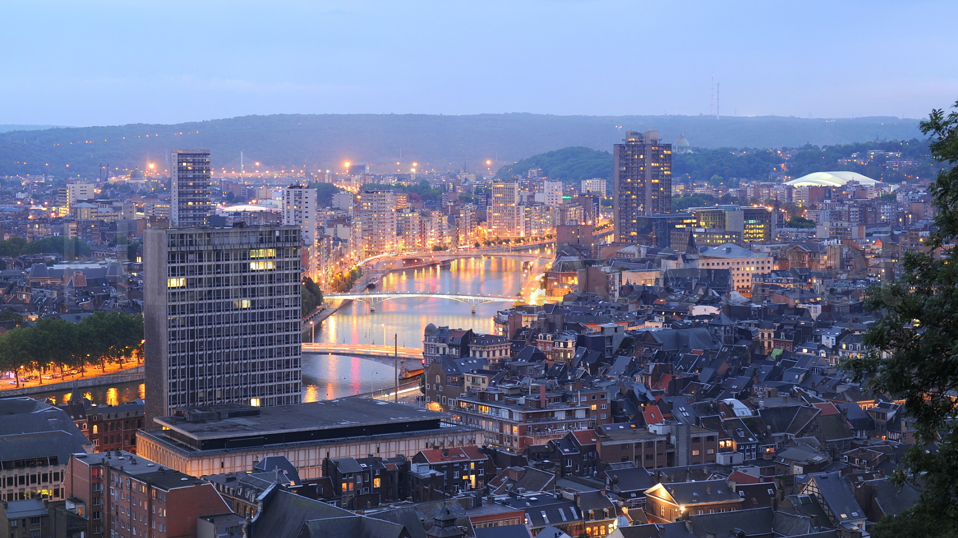
User Experience in the age of AI
Afelio

Slide 2


HR RECRUITER
Sarah Bebronne

Slide 3
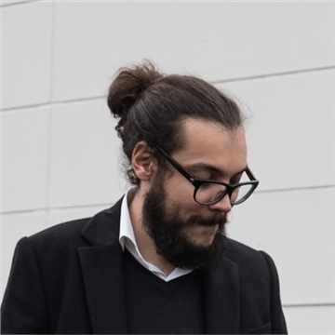

Julien Houbrechts
EXPERIENCE CAPTAIN
PROFESSEUR INVITÉ
Ecriture Multimédia
eBusiness

Slide 5


Slide 6
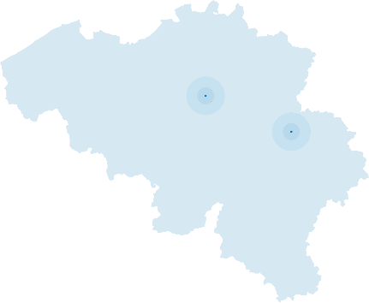


A young and talented team
Managers & Coaches
UX engineers
Projects Managers
Heverlee
+160 employees
2023
Liège
UX designers
Charleroi
Digital Analysts
Technical Experts

Slide 7




What we do
We support and advise
We implement and optimize
User Experience & Agile
Web & Native development

Slide 8

Enterprise Value
Web agencies
IT Providers
User
IT
integration
Notes:
Chapitre: BUIDLING TRUST AND DIFFERENTIATION (cont’d)
Objectif : rendre explicite notre positionnement unique
Style de présentation :
« informatif – descriptif »
Exemples de commentaires pour ce slide :
A notre connaissance, nous n’avons pas de véritable concurrence.
Aujourd’hui, il y a 2 grandes catégories de fournisseurs IT. D’un côté les agences digitales, centrées sur l’expérience utilisateur car souvent provenant du B2C, avec pour objectif la conversion rapide. L’UX est implantée depuis très longtemps dans leur AND. D’un autre côté les grands intégrateurs, spécialistes en IT qui se concentrent sur les besoins métiers. Ils prennent les cahiers des charges et délivrent une appli telle quelle, avec comme hypothèse que l’utilisateur s’adaptera. Ils répondent aux spécifications techniques, et le font très bien. Entre ces 2 types de fournisseurs, il y a un vide. Ou plutôt, il y avait. C’est le positionnement que nous avons choisi et qui nous réussi.
Afelio tient compte des 3 éléments dans un contexte B2B. On repart de l‘expérience UX propre aux agences web, on capitalise sur notre expérience groupe dans le domaine IT et on tient bien entendu compte de la valeur business que doit délivrer les applicatifs.
Les alternatives sont constituées soit des agences web
Exemples de questions pour susciter le dialogue :
Afelio se positionne au centre des 3 cercles,

Slide 9
We care about users of digital products

Slide 10

Users

Slide 11
UX Design

Slide 12
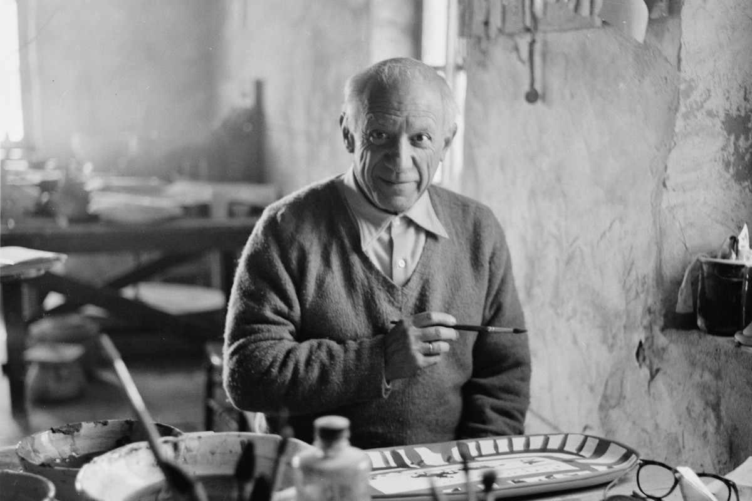
Notes:
Pablo Picasso

Slide 13
Design
the conscious and intuitive effort to impose meaningful order

Slide 14


Slide 15
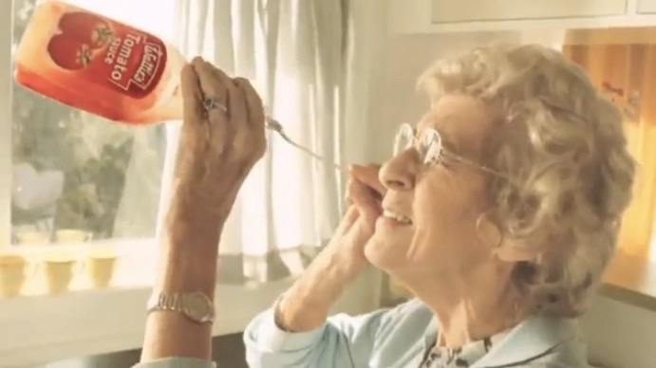

Slide 16
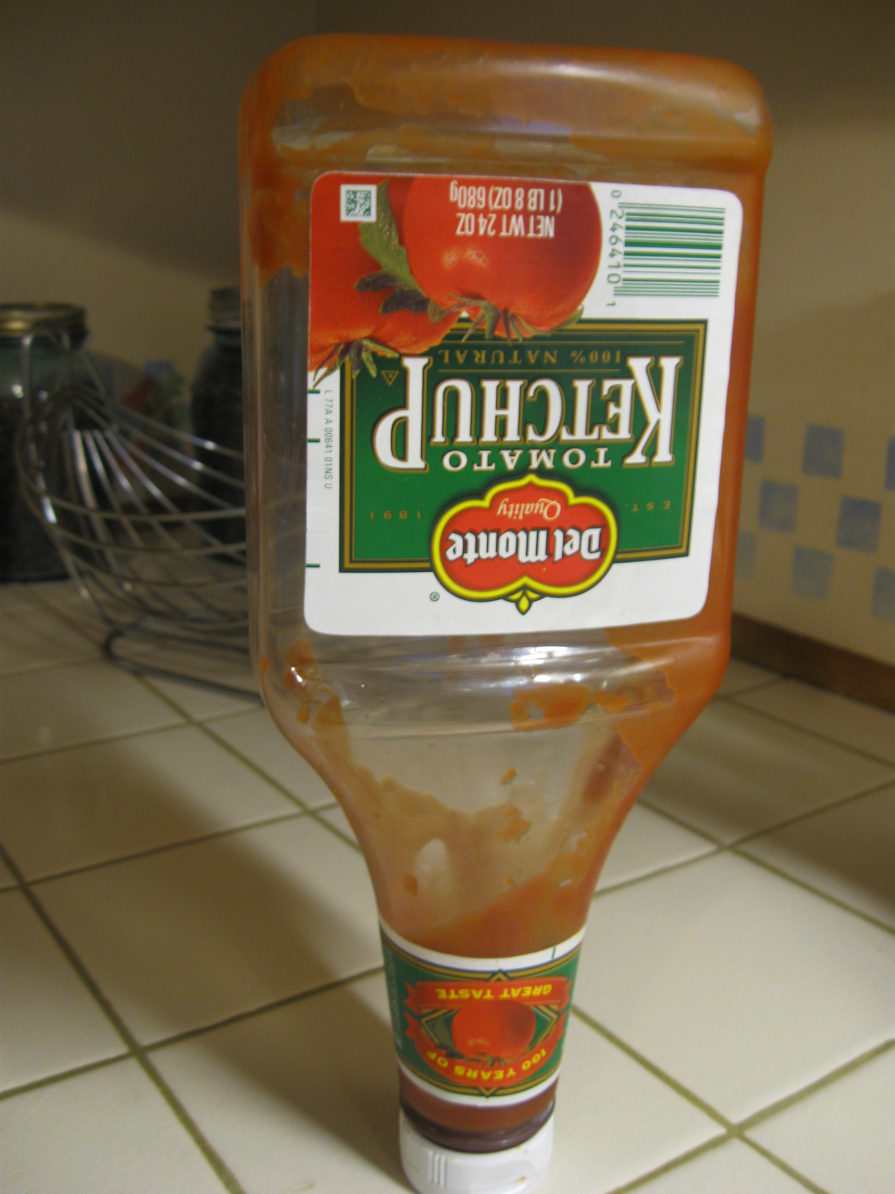

Slide 18
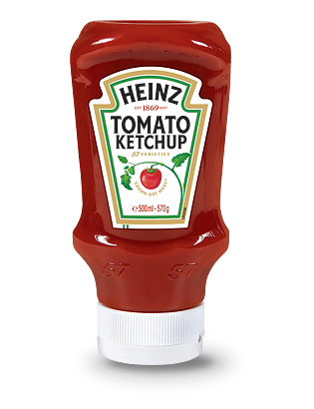

Slide 19
User Experience
A seamless merging of the services of multiple disciplines, including engineering, marketing, graphical and industrial design, and interface design.

Slide 20
This is how we do

Slide 21
Usage is the most important part

Slide 22

USER CENTRIC

Slide 23

Expressed needs
Latent needs
Notes:
the designer’s job is to look beyond the task to identify who the most important users are, and then to determine what their goals might be and why.

Slide 24
Notes:
know your user base, their habits and tendencies, and why they do or do not perform certain actions.
User Requirements: Who is this product for? Who is the main audience? Is there a fringe audience and, if so, who is it? Does it cover your entire user base or support a subset?

Slide 25
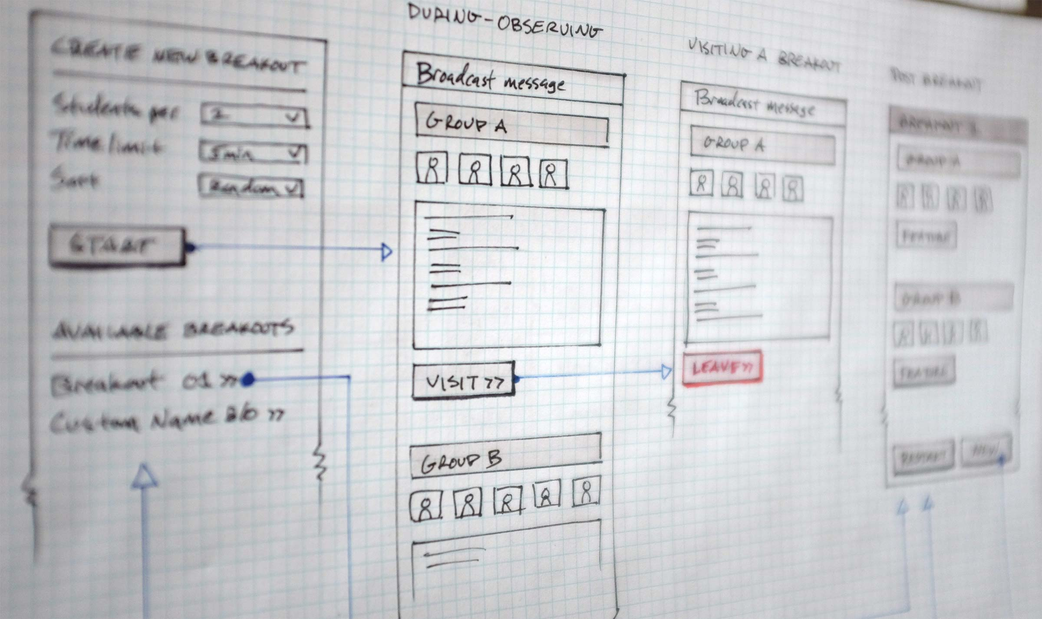

Slide 26


Slide 27
Fail fast
Learn
Try again

Slide 28
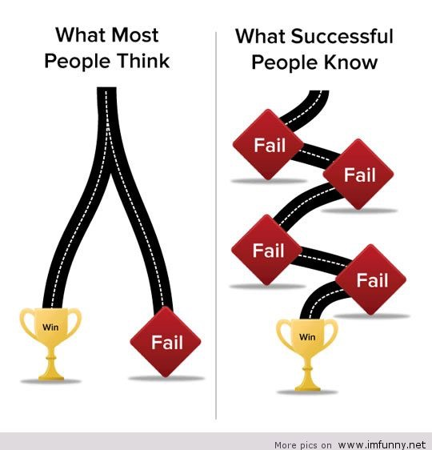
VALIDATED BY USER TESTS
Stop gambling
Notes:
Utipoque de croire que l’on peut ne pas faire d’erreur, et qu’il y a une « route » vers le succès, ou vers l’échec.
D’où la nécessité de faire différentes itérations, validées sur le terrain, pour affiner le modèle et le rapporcher des besoins utilisateur.
Autant d’itérations que nécessaire pour arriver à la bonne application.

Slide 29
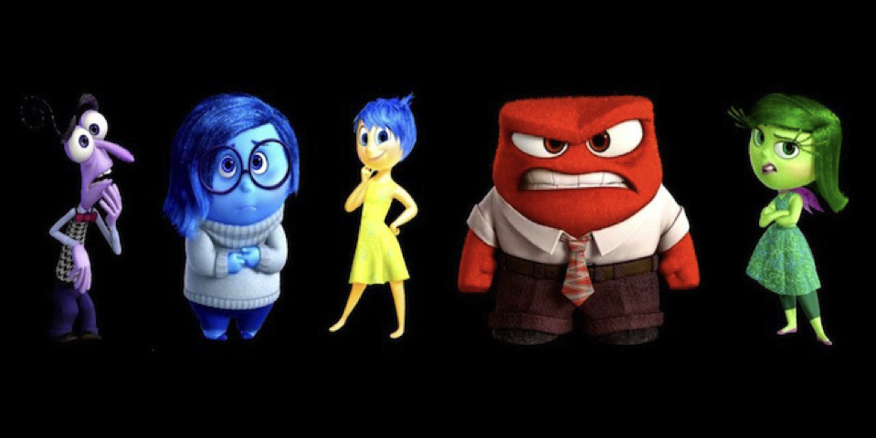

Slide 30



Facial expressions
Galvanic
Skin
Response
Eye Tracking
Notes:
Logiciel d’analyse d’expression faciale via la webcam
Un sourcil qui se lève, une coin de la bouche qui s’active, le logiciel enregistrer et analyse ses mouvements pour interpréter des réponses émotionnelles En adéquation avec le capteur d’activité électrodermale (Galvanic Skin Response GSR en anglais). Captation des activités des glandes de sudation et du système nerveux pour percevoir des comportements parfais involontaires de l’individu. Sert à valider les expressions faciales enregistrées ou déceler des situations de réponse émotionnelle invisibles. Capteur de suivi de regard (eye-tracking) pour enregistrer le chemin de l’oeil de l’utilisateur sur l’écran. Des données très importantes pour savoir comment est scanné un écran. Enquête pour recueillir des informations ou des retours d’expériences sur nos utilisateurs testés

Slide 31
Digital world is evolving.
Fast.

Slide 32
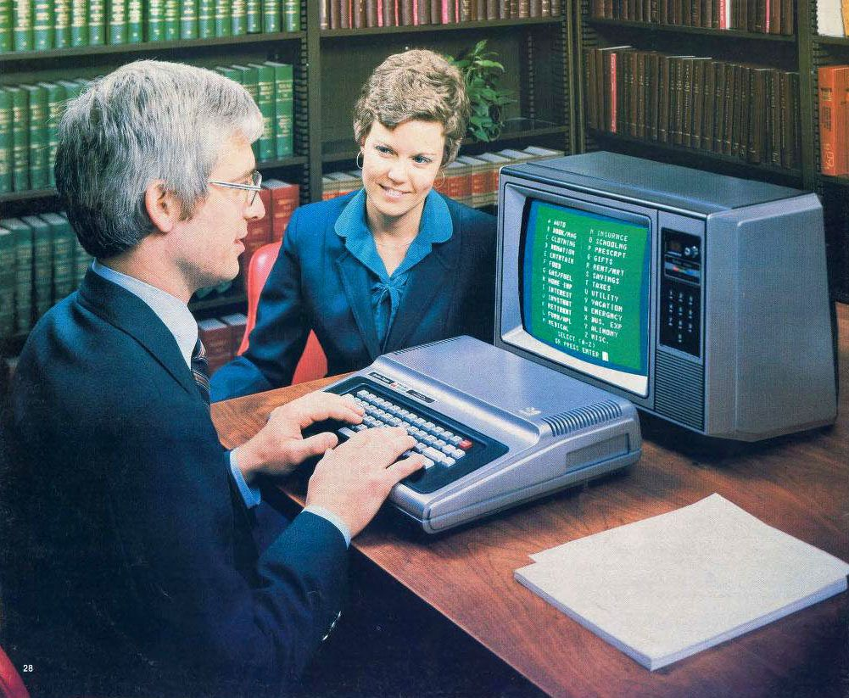

Slide 33
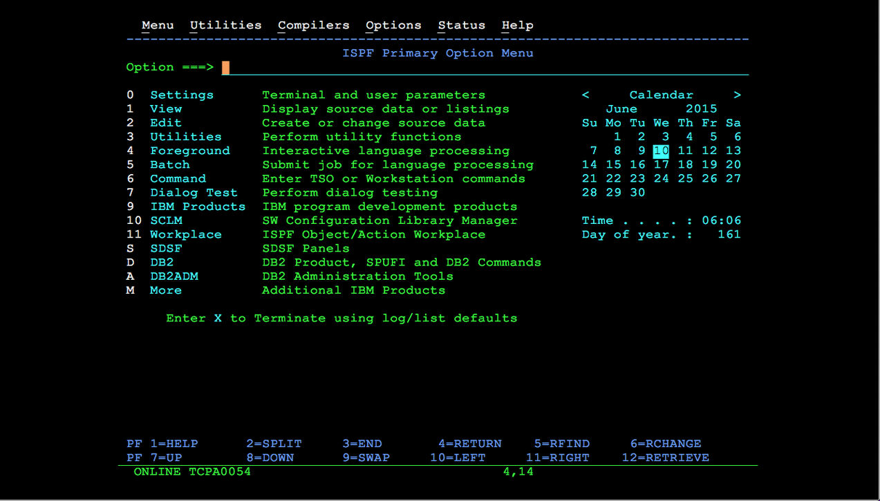

Slide 34


Slide 35
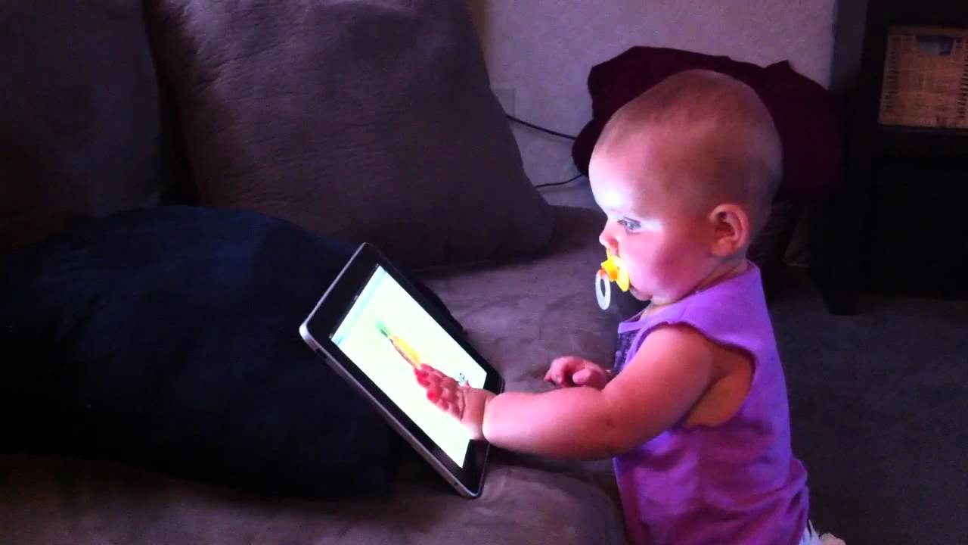

Slide 36
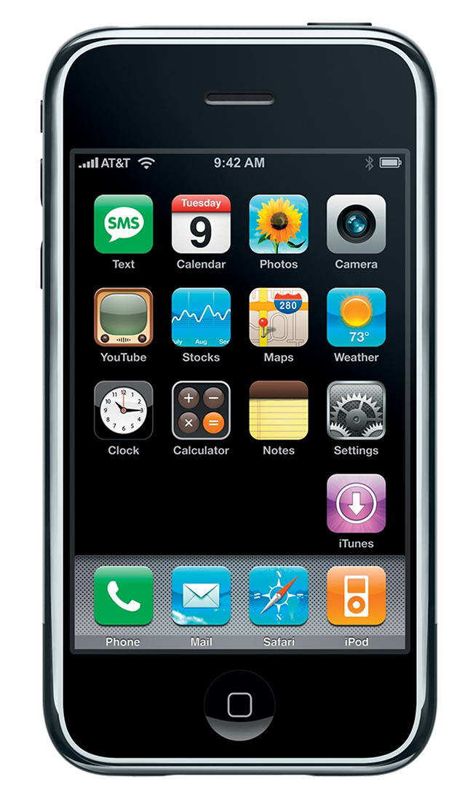
IF YOU DON’T MIND EXPERIENCE, SOMEBODY WILL

Slide 37
Innovation distinguishes between a leader and a follower.
Steve Jobs

Slide 38
Today, it’s all about AI.

Slide 39


Slide 40
AI, through large language models (LLMs), has already invaded our lives in many ways. For example, LLMs can generate realistic text, speech, and images for various purposes, such as entertainment, education, and communication.
LLMs can also understand natural language and answer questions, provide suggestions, or perform tasks for us. LLMs are behind many applications and services that we use daily, such as search engines, social media platforms, virtual assistants, and chatbots.
Notes:
And I won’t surprise you if I said that this slide was generated by Bing.

Slide 41
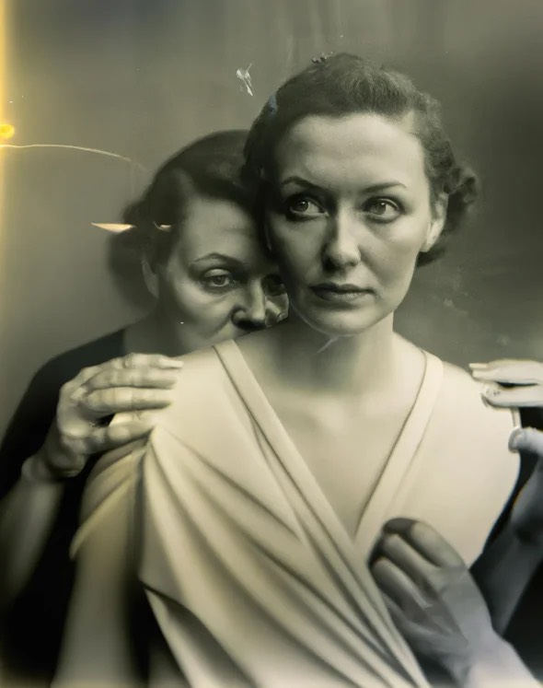
Notes:
AI Generated photograph - contest winner

Slide 42
Don’t fight change.
Embrace it.

Slide 43
How can you help us ?

Slide 44
Our vision is to always maximize technological opportunities. Here for we'd like to reflect on how to integrate these advancements into our work, while adhering to security guidelines and meeting customer requirements.

Slide 45
A.I. might not replace you, but a person who uses A.I. could
Paolo Confino
Fortune
Notes:
https://fortune.com/2023/04/25/artificial-intelligence-ai-replace-humans-prompt-engineers-chatgpt/

Slide 46
How can you help us ?

Slide 48
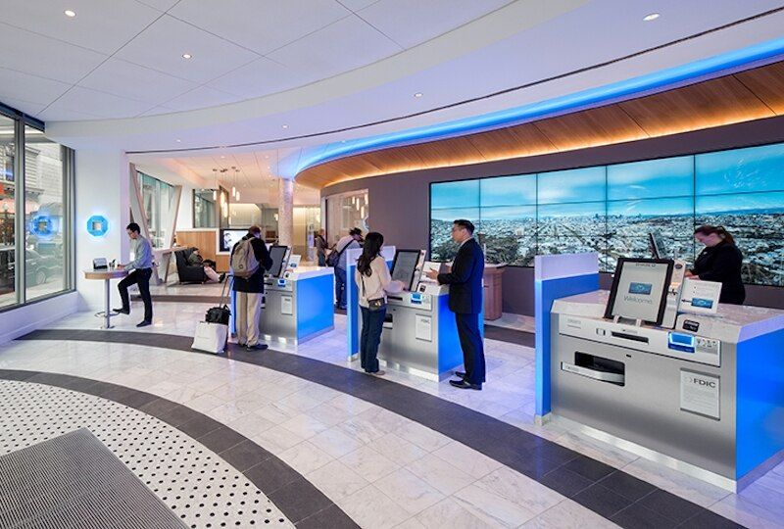
Notes:
how many of you have set foot in a bank branch recently?

Slide 49
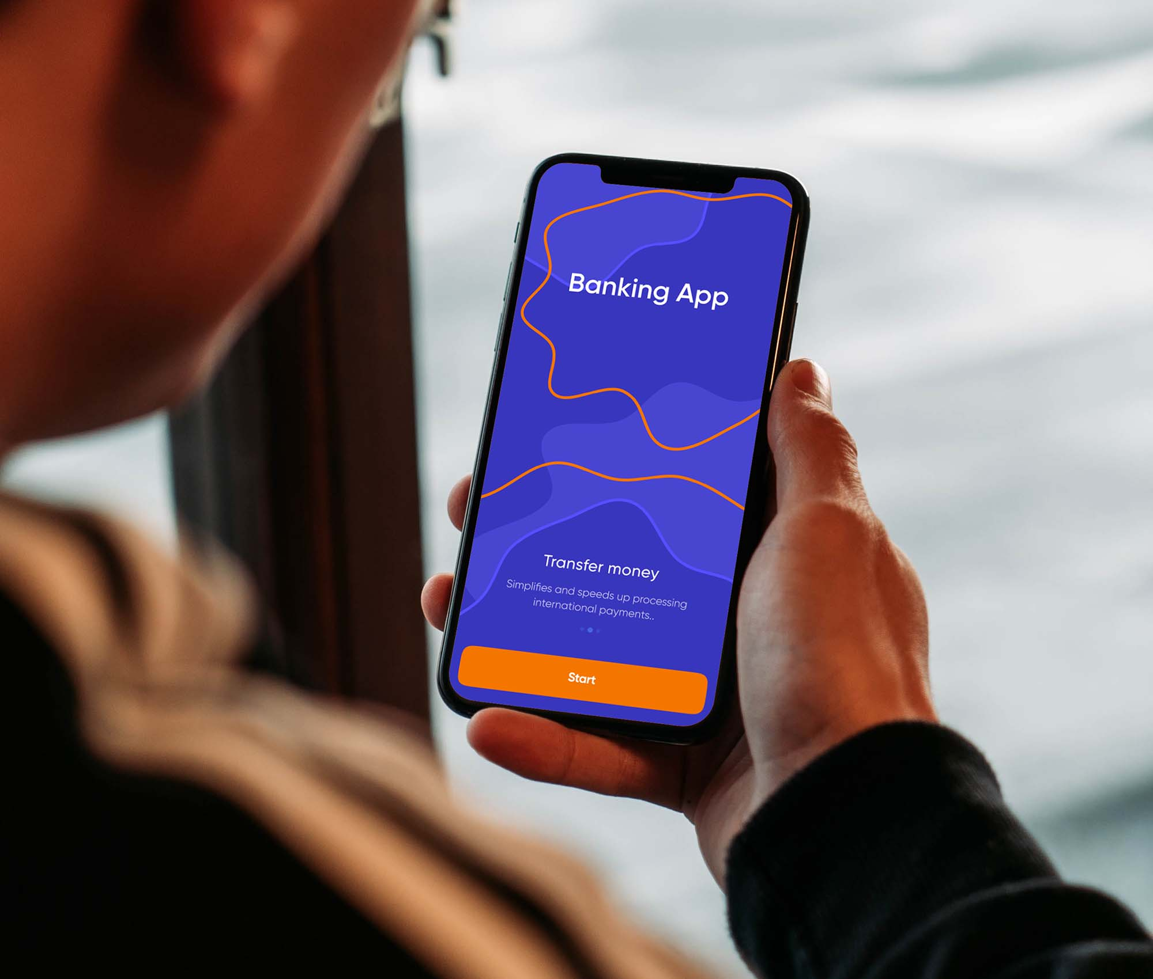
Notes:
The banking sector has long since embarked on and succeeded in its digital transformation, meaning that the maiority of its processes, both internal and external are digital

Slide 50
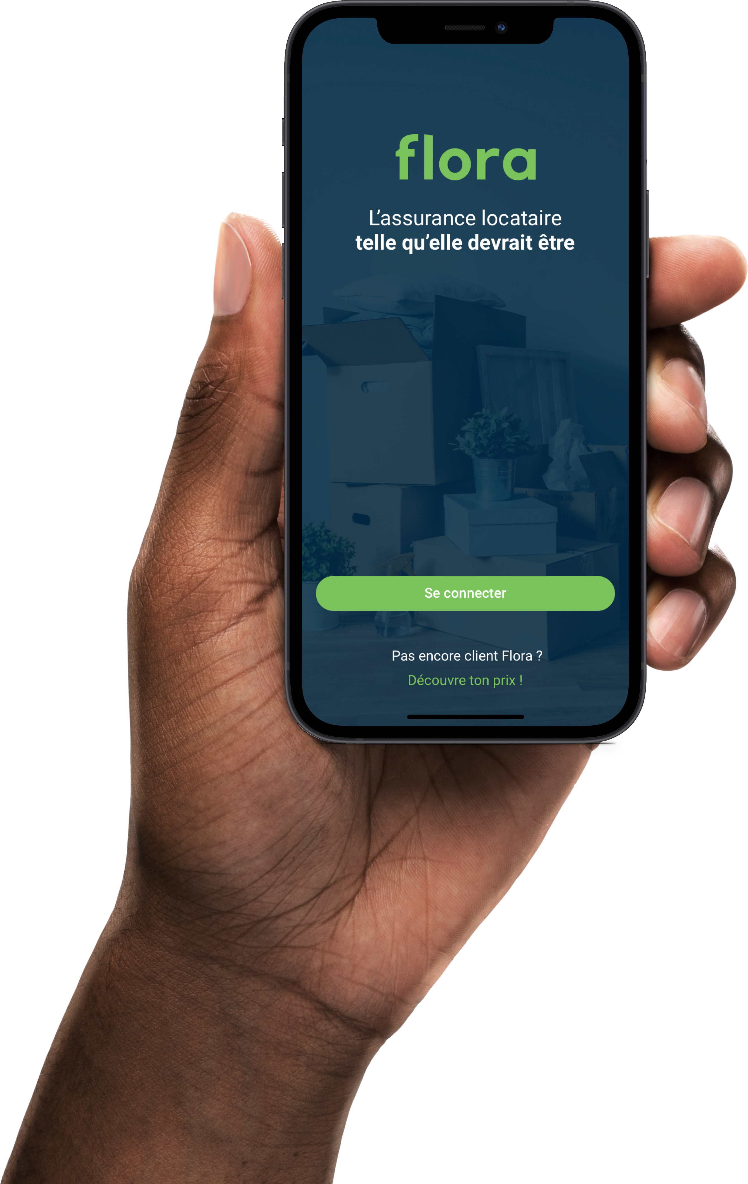
Notes:
The insurance sector is following the same path; it is now easy to subscribe to an insurance online, and Afelio/NRB Group has participated in the design of the 1st Belgian 100% digital insurance for tenants.

Slide 51

Notes:
However, many steps still involve delaved processing, which can take days or even weeks, and do not provide an optimal customer experience.

Slide 52
Subscription
Notes:
- ﻿Subscription, which in some cases requires manual verification before signing the contract.

Slide 53
Claims process
Notes:
The claims process, i.e. the reimbursement requests of the insured, once an accident has occurred, can involve several profiles: file manager, expert mandated to analvze the damage, security checks to avoid fraud,...

Slide 54
Numerous and complex documents
Notes:
From the insured's point of view, the numerous and complex documents to be filled in are also opportunities for misunderstandins, and therefore for errors.

Slide 55
Use the possibilities of Al (LLM, image recognition) to streamline the process, from underwriting to reimbursement.

Slide 56
Use your skills

Slide 57
Teamwork
👯‍♀️
Divide the problem into sub-problems and distributes them
Subscription process
Claims process
….

Slide 58
Creativity
🤪
Creativity is about finding a new solution to a known problem
Quantity over quality
Defer judgement
Embrace wild ideas
Fail fast, fail often
Show, don’t tell
Build on top of ideas of others

Slide 59
Problem solving
🕵️
Don’t forget business concerns
Avoinding fraud
Keeping a good quality of service

Slide 60
Critical Thinking
🧐
Ethics is a critical part in implementing AI.
Security
Accuracy
Potential job losses

Slide 61
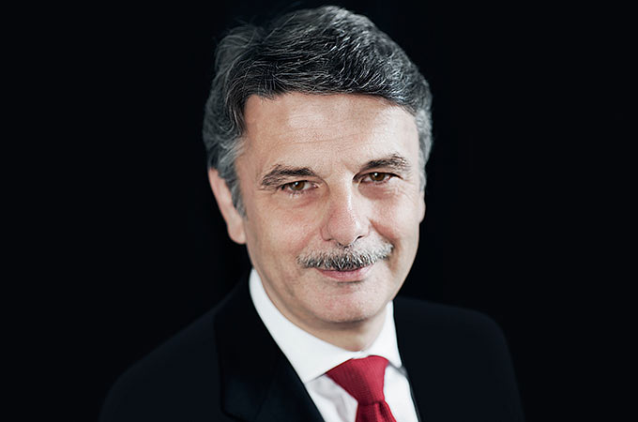
If you think good design is expensive, you should look at the cost of bad design.
Ralph Speth

Slide 62
keep in touch
linkedin.com/in/sarah-bebronne-339208136/
linkedin.com/in/juhoub
afelio.be

